Slide 1
CS 131 Lab 0
Let’s write a program in the Eclipse IDE, Create a Github repository and save our work!

Slide 2
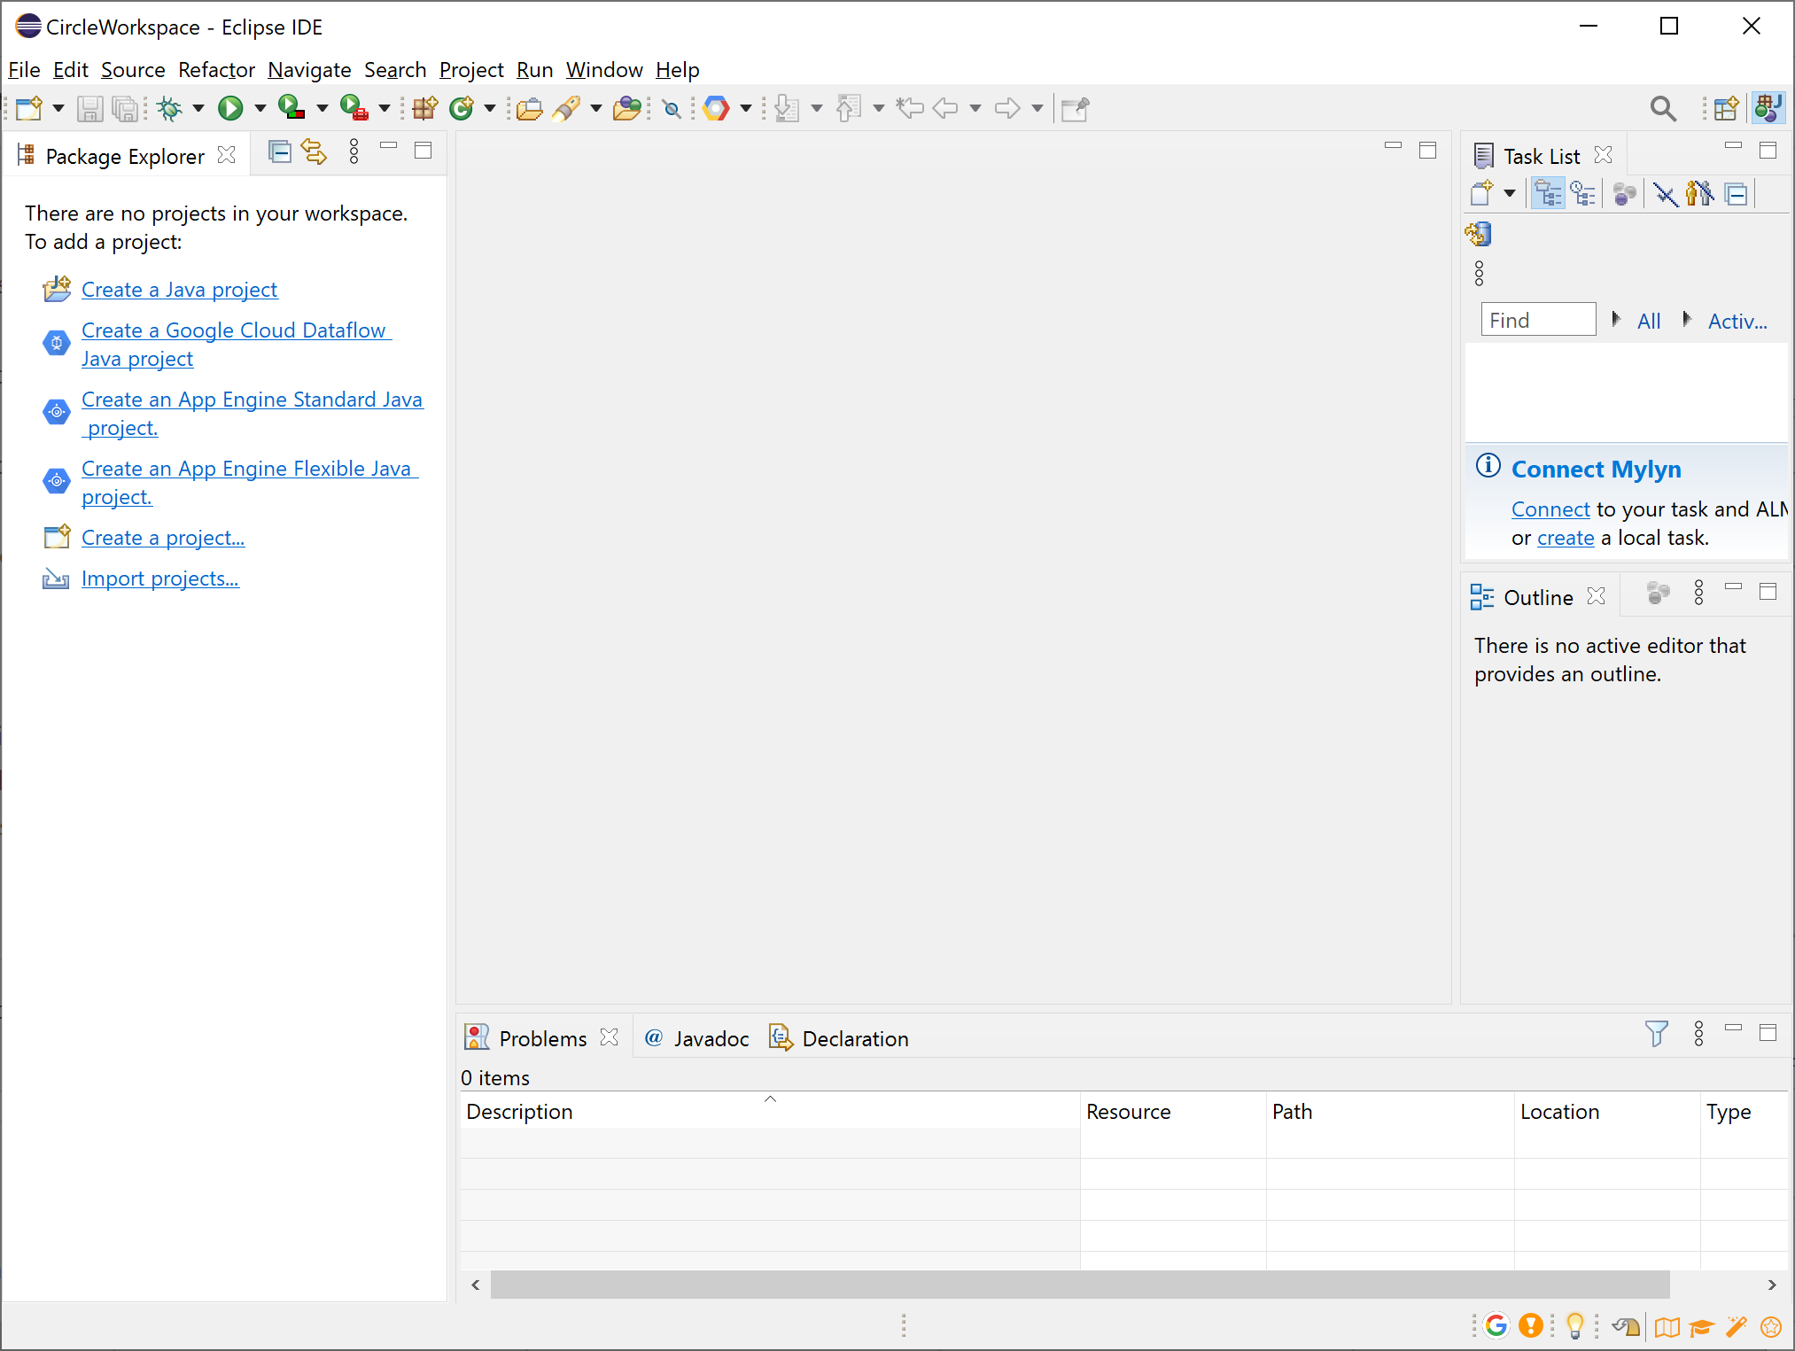
Create your Eclipse Project

Slide 3
Create a Java Project

Slide 4
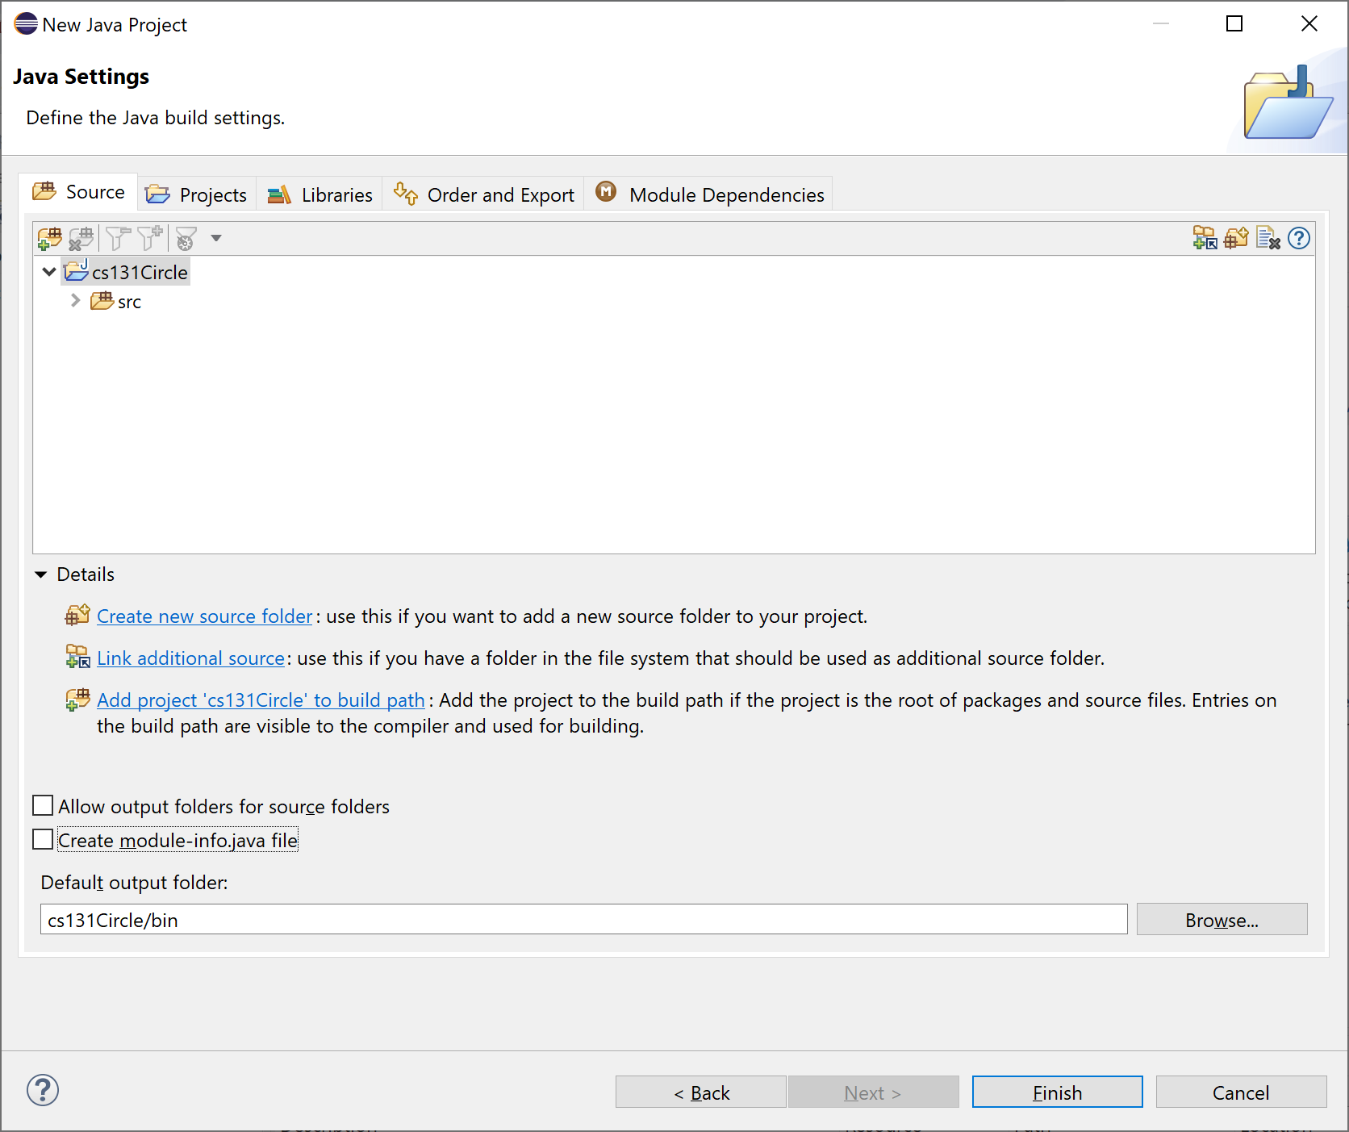
Uncheck Create module-info:

Slide 5
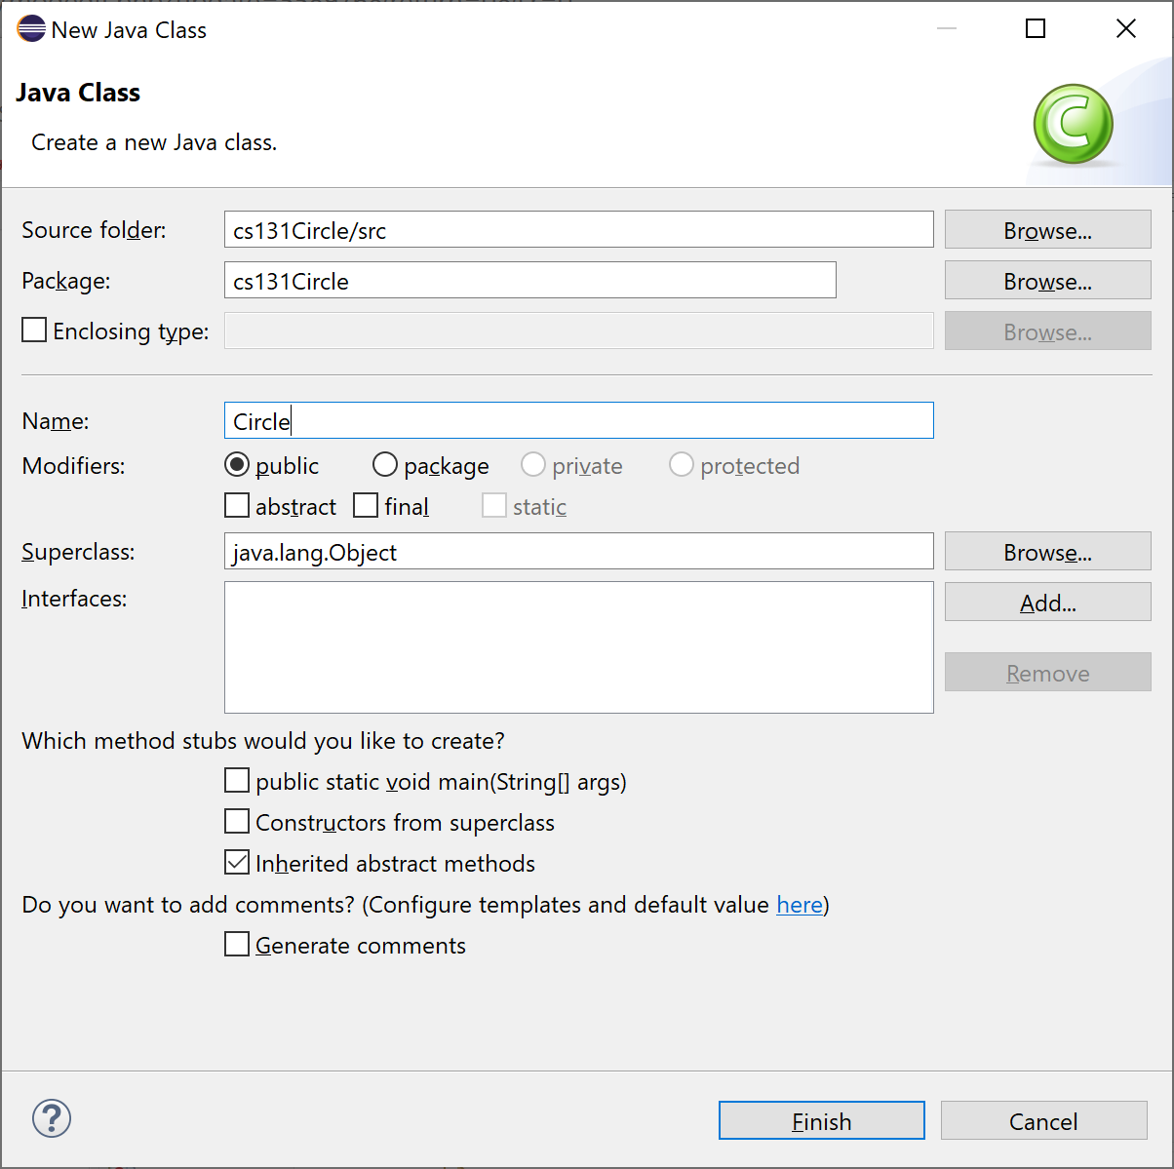
Select File/New/Class and create a class. Be sure to name it starting with a capital letter!

Slide 6
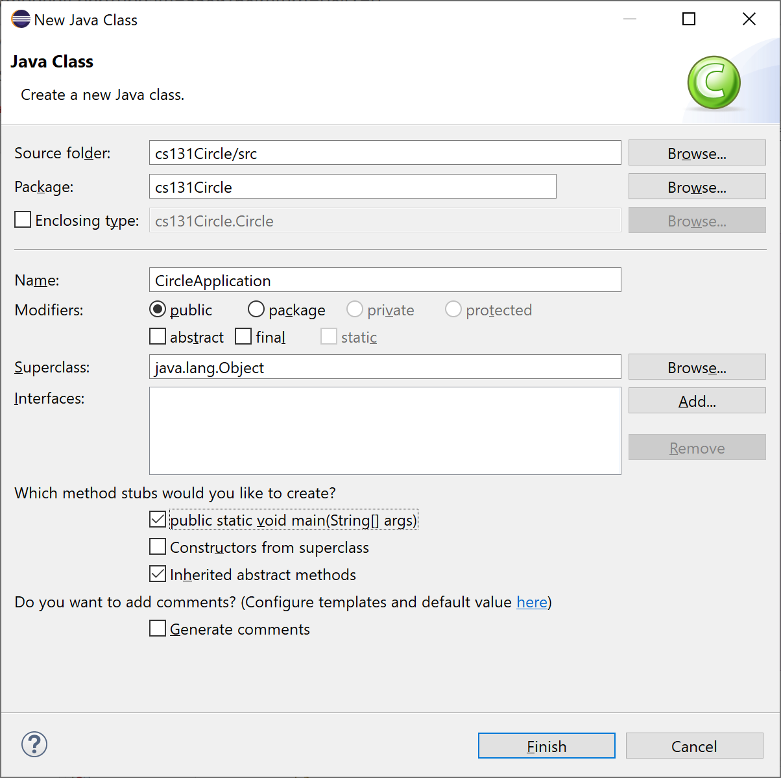

Slide 7
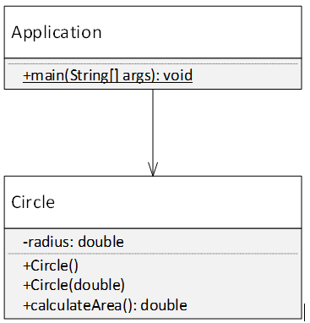
Write the code for the circle and circle App class!

Slide 8
Create GitHub Account
https://github.com/join?ref_cta=Sign+up&ref_loc=header+logged+out&ref_page=%2F&source=header-home

Slide 9
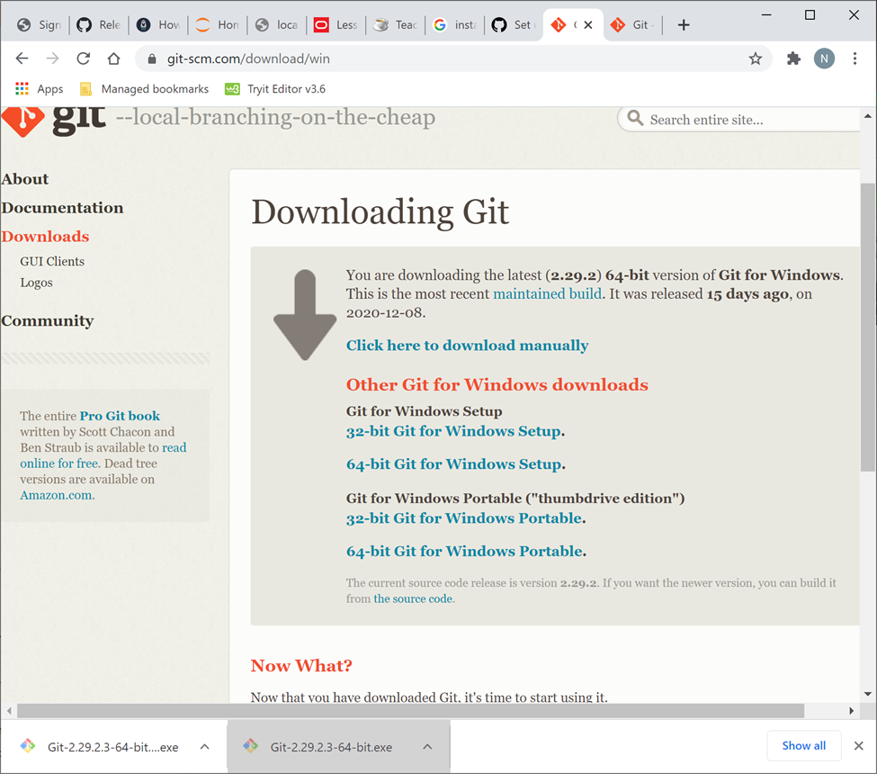
Install Git

Slide 10
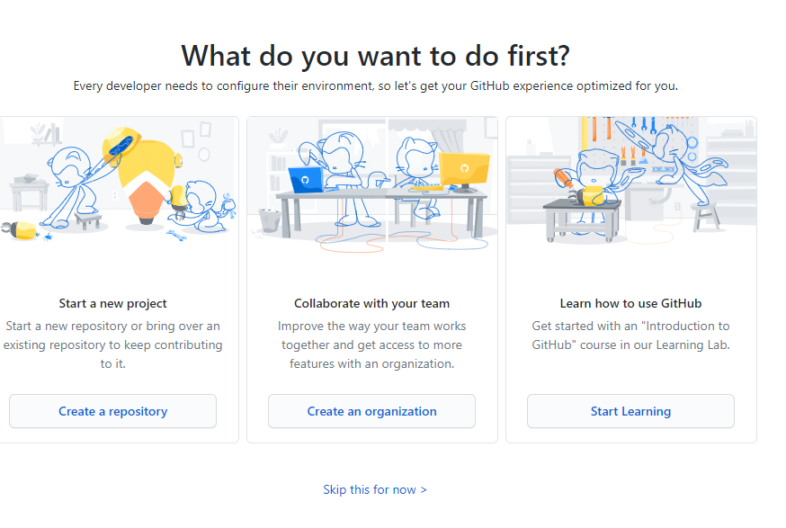
Log Into GitHub

Slide 11
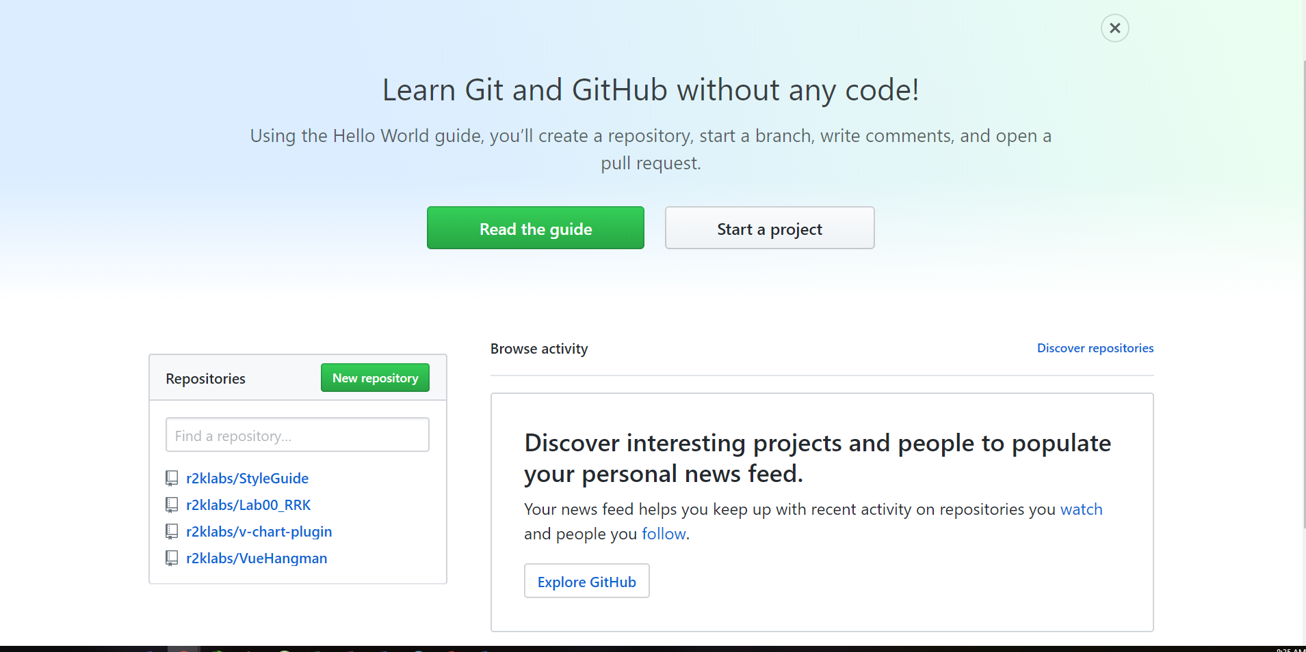
Steps for creating GitHub/Git Repository
Create your repository in GitHub first

Slide 12
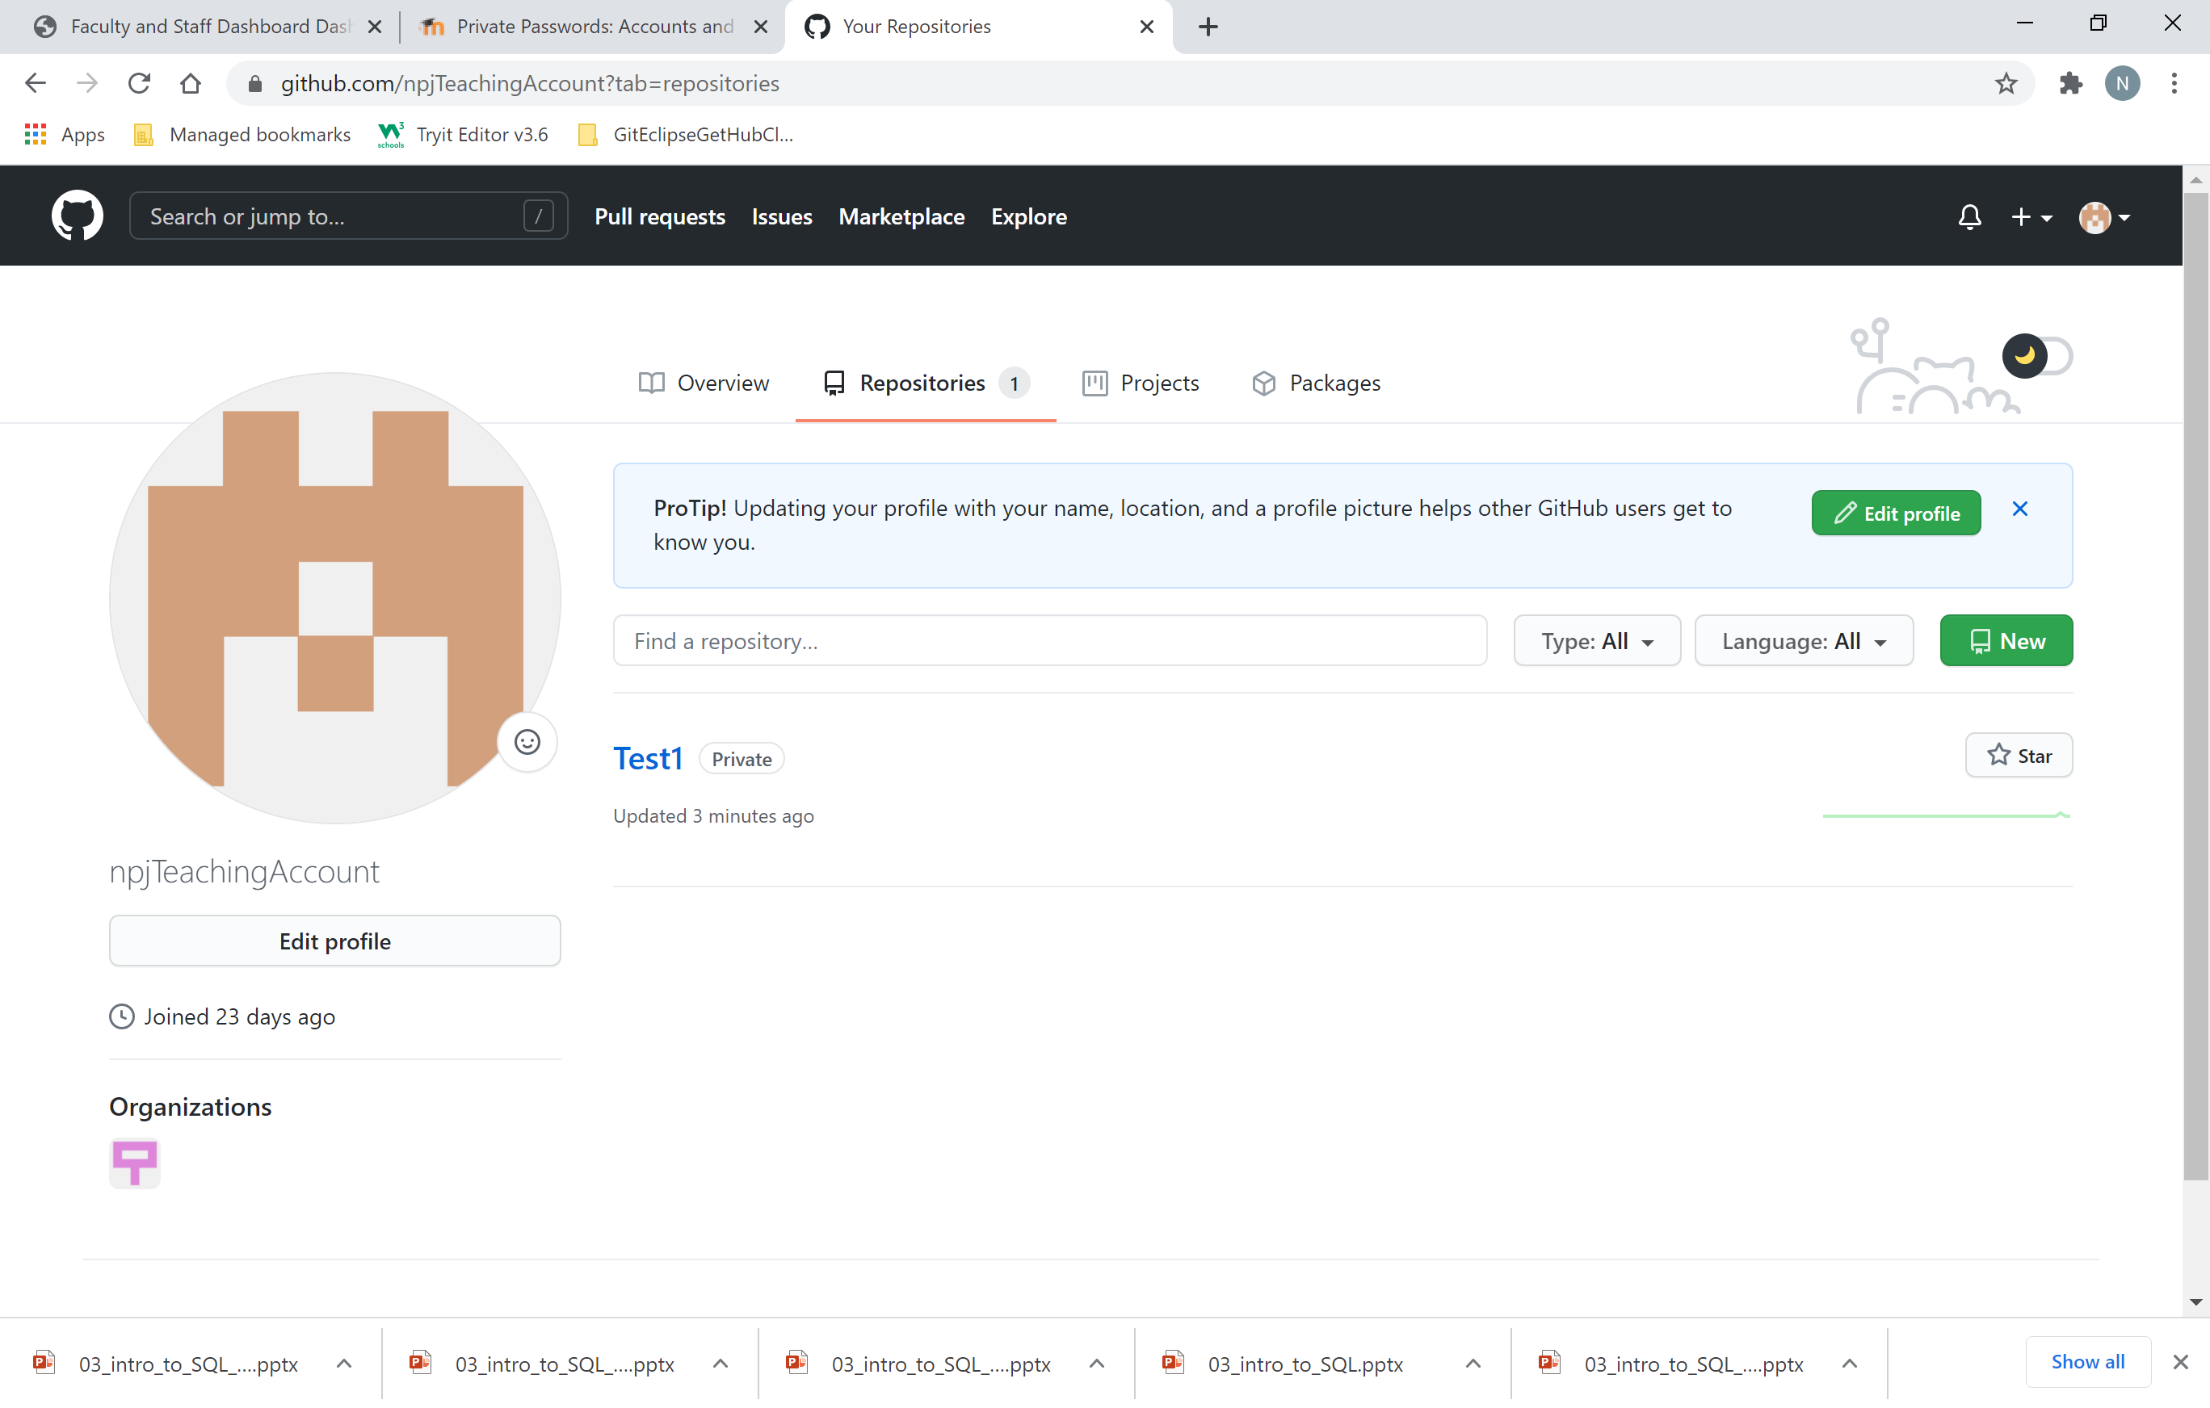

Slide 13
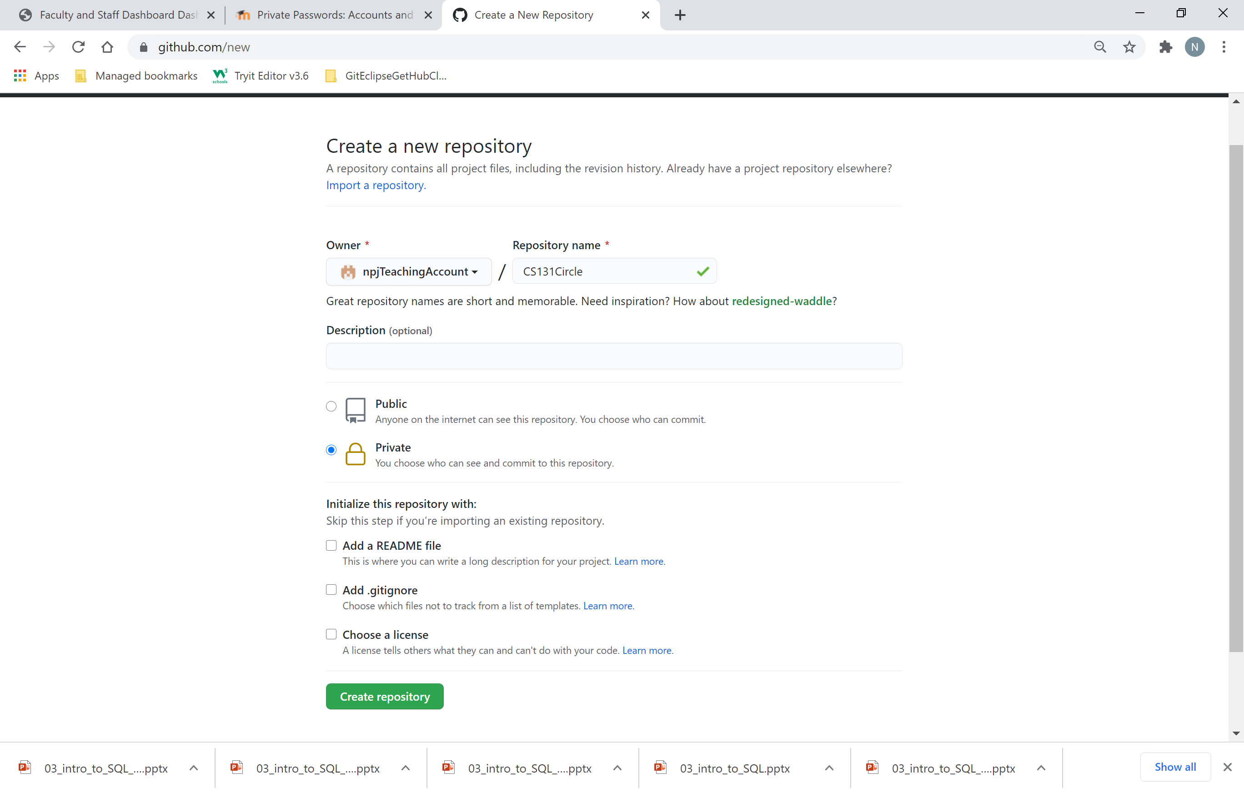
Make it public!!!

Slide 14
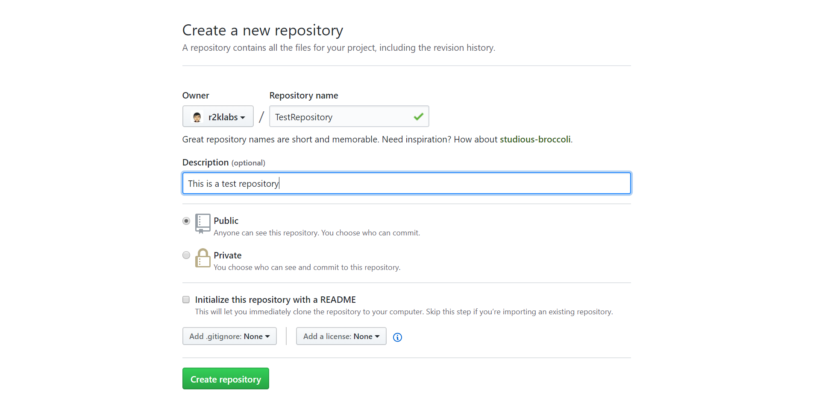
Steps for creating GitHub/Git Repository
Create your project in GitHub first

Slide 15
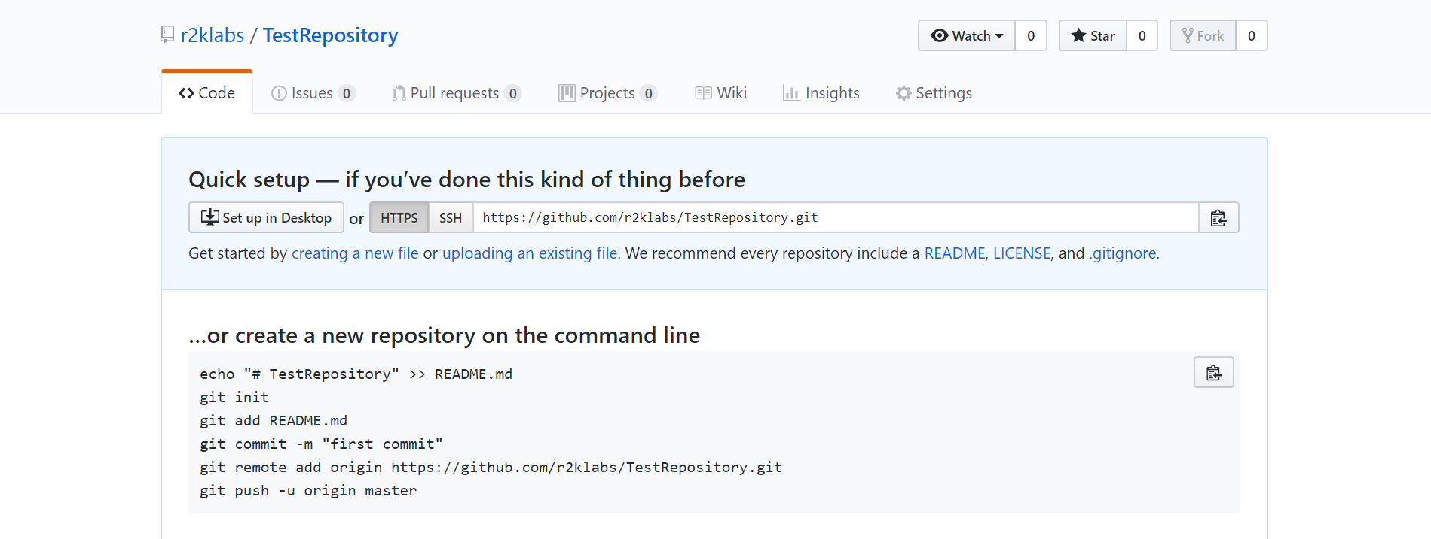
Steps for creating GitHub/Git Repository
Run the commands on your local machine

Slide 16
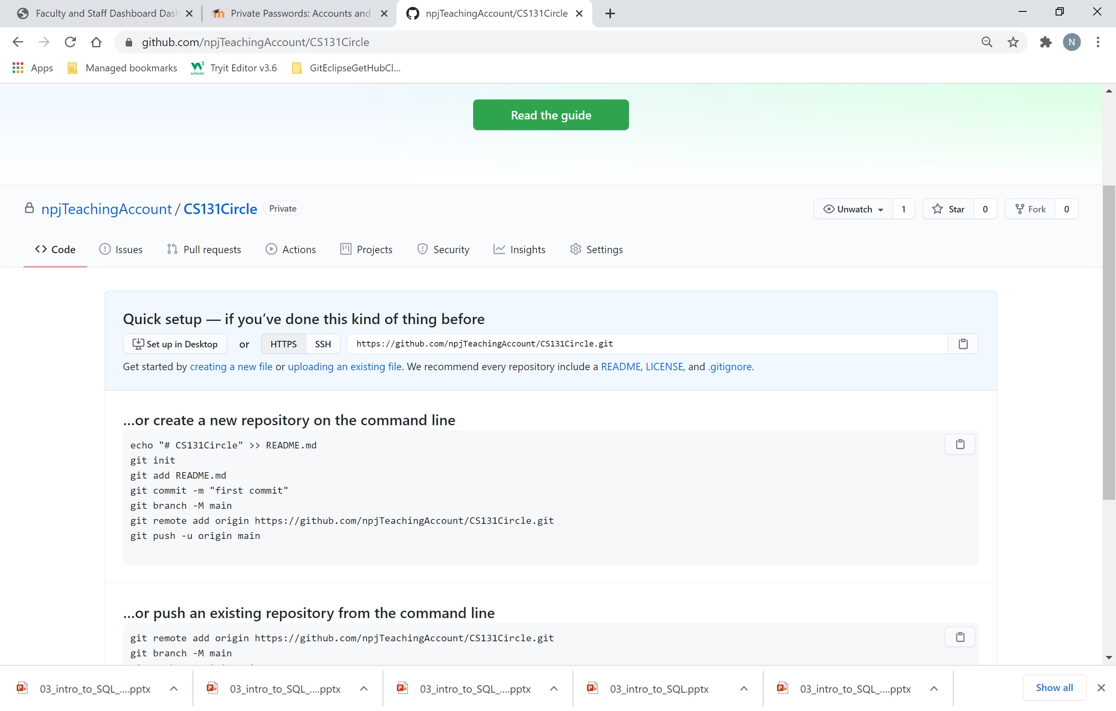
Grab the link: https://github.com/npjTeachingAccount/CS131Circle.git

Slide 17
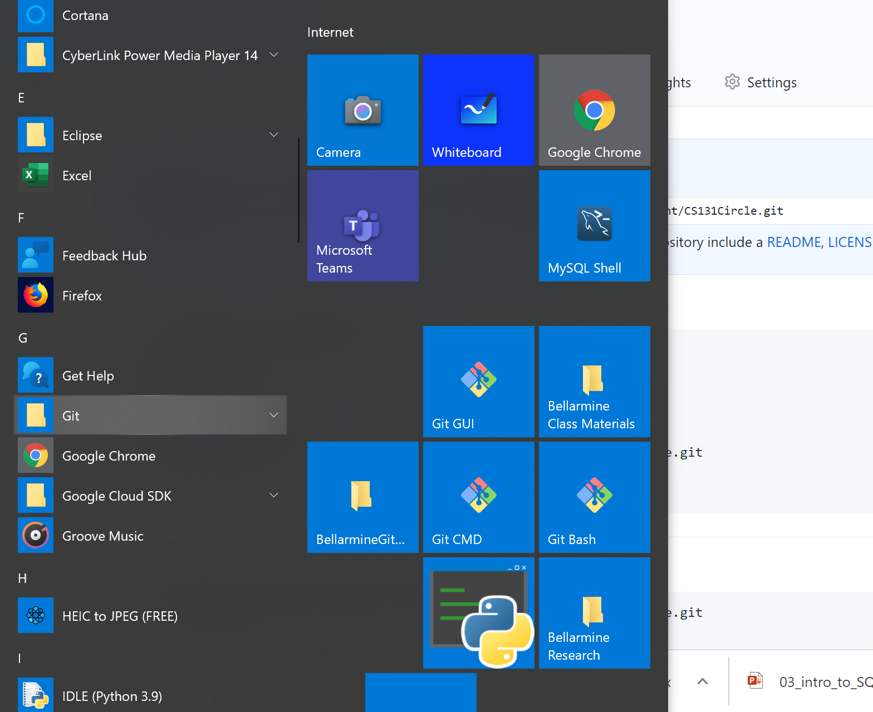
Run Git:

Slide 18
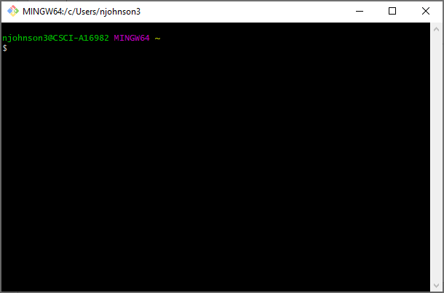
Git Bash (Bourne Again Shell)

Slide 19
CD to your workspace in Eclipse: C:\Users\njohnson3\Google Drive\EclipseWorkspace\CS131Workspaces\CircleWorkspace You will make this a git repository using git. Type the following commands into the Bash shell.

Slide 20
Grab the link: https://github.com/npjTeachingAccount/CS131Circle.git

Slide 21
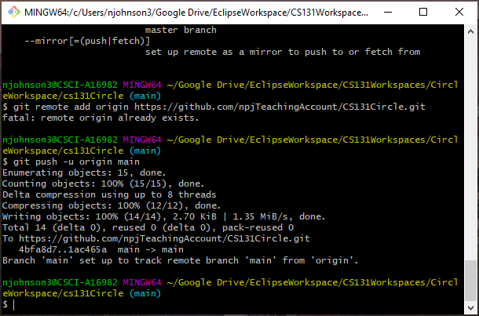
Be sure to git add . (Note the period for current directory)

